Slide 1
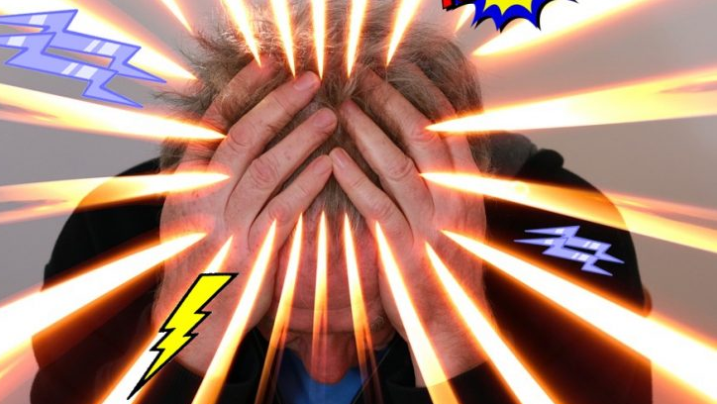
The Bible’s answer to stress and discouragement
Piroska Down

Slide 2
Stress
We live in a stressful environment. Our lives might be much easier physically than our grandparents’ lives as we have much more comfort than human beings ever had.
Questions:
Are we more stressed than generations were before us?
Do we really have more pressure on us now than people used to have in the past or simply we can’t handle pressure as well as our ancestors did?
Why are we emotionally more vulnerable than people used to be in the previous centuries?
Notes:
Are we more stressed? – Definitely. Stress was always present in people’s lives, but after it ran its course, there was a resolution. In our days, stressful situations are much more frequent and often prolonged. We are much more stressed about factors such as extremely high expectations or time or targets at work or a lot of travel, traffic on the roads etc. These factors didn’t exist in the past.
I believe the answer to this question is yes in both ways: we have more pressure on us than people used to have, but it’s also true that we don’t really handle pressure well, because we are emotionally more vulnerable than our ancestors were by default.
Why are we emotionally more vulnerable than people used to be before? – I believe that today’s generation is not resilient enough due to all sorts of factors such as media pressure, being socially more isolated as our ancestors lived in much tighter social groups, etc and – exactly because our comfortable life style automatically makes us less resilient towards difficulties.

Slide 3
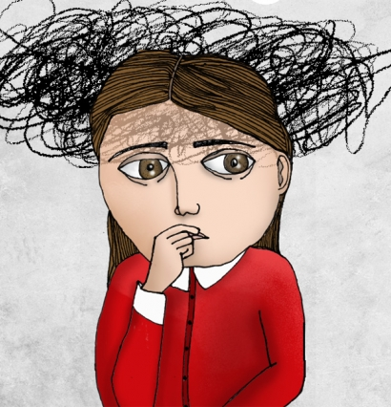
Definition of stress
When we say things like "this is stressful" or "I'm stressed", we might be talking about the following:
Situations or events that put pressure on us
Our reaction to being placed under pressure
https://www.mind.org.uk/information-support/types-of-mental-health-problems/stress/
Definition:
“Stress is the feeling of being under too much mental or emotional pressure. Pressure turns into stress when you feel unable to cope.” (NHS Inform)
Notes:
“What is stress?
We all know what it's like to feel stressed, but it's not easy to pin down exactly what stress means. When we say things like "this is stressful" or "I'm stressed", we might be talking about the following:

Slide 4
The nature of stress
Stress affects everyone – different types of stress – one-time or short-term occurrence or long-term
Not all stress is bad – sometimes stress can motivate people – a job interview or an exam
Long-term stress can harm your health – in chronic stress the body never receives a clear signal to return to normal functioning. People can experience symptoms such as sleeplessness, sadness, irritability or digestive symptoms.
Long-term stress can lead to more serious conditions, such as discouragement, anxiety and depression.

Slide 5
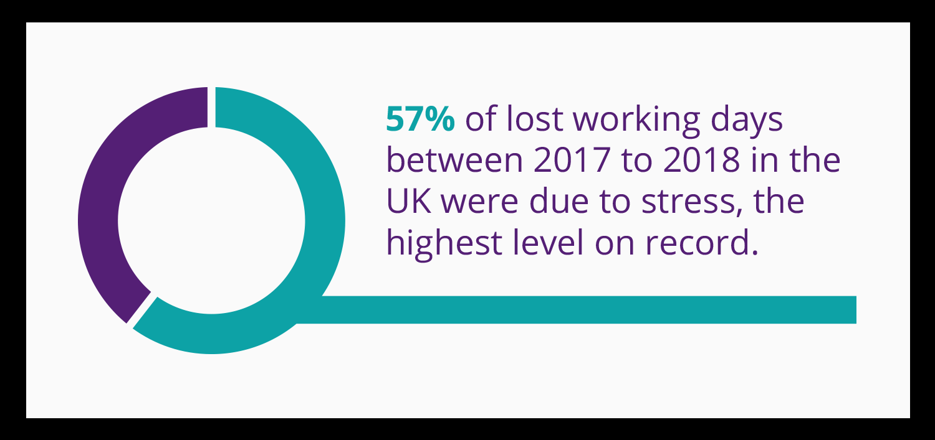
Statistics
“74% of UK adults have felt so stressed at some point over the last year they felt overwhelmed or unable to cope. – it means 3 out of 4 adults
83% of 18-24 year-olds said this compared to 65 percent of people aged 55 and over.” (www.mentalhealth.org.uk)

Slide 6
Stress and discouragement in the Bible
Notes:
However, my purpose today is not to go deeper into the medical side of stress. I would like to examine this topic from a different side, looking into what the Bible says about this topic or the solution it suggests.

Slide 7
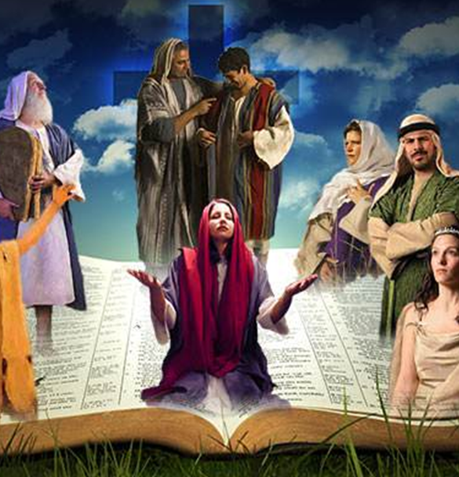
Bible characters who experienced stress and discouragement
Throughout the Bible, there are a number of stories about godly, influential men and women of faith, who struggled and battled through dark times of hopelessness and depression.
Can you name a few of them?
These stories show how God deals with people who are burnt out.
Notes:
Can we name characters in the Bible who suffered from stress and discouragement?
Elijah
Jonah
David
Joseph
Moses
Jeremiah
Job etc

Slide 8
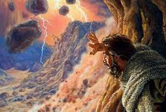
1. Elijah
Elijah was discouraged, weary, and afraid.
After great spiritual victories over the prophets of Baal, this mighty man of God feared and ran for his life, far away from the threats of Jezebel. And there in the desert, he sat down and prayed, defeated and worn:
“I have had enough Lord, he said. Take my life, I am not better than my ancestors.” (1 Kings 19:4)
God solution was to send an angel, who gave him food and water to strengthen him. (1 Kings 19:4-9)

Slide 9
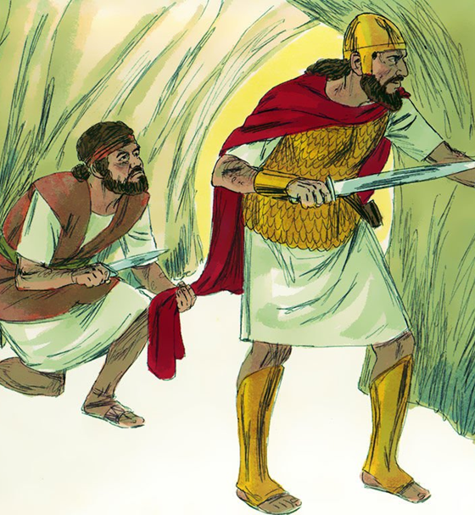
2. David
David was troubled and battled deep despair.
Psalms – anguish, loneliness, fear of the enemy, crying over sin and guilt.
“My guilt has overwhelmed me like a burden too heavy to bear.” Psalm 38:4
“Why are you downcast, O my soul? Why so disturbed within me? Put your hope in God for I will yet praise him, my Saviour and my God.” Psalm 42:11
What was God’s attitude towards David? David is known as “a man after God’s own heart” (Acts 13:22)

Slide 10
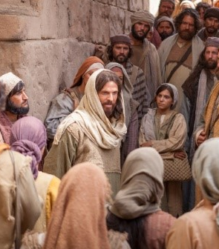
3. Jesus
Have you ever thought about Jesus facing stress and discouragement? Jesus was constantly under pressure.
No privacy – there were always lots of people around him
No permanent home – no guaranteed source of food
People repeatedly misunderstood, criticised, and ridiculed Him.
Notes:
Jesus was constantly under pressure. There were many demands on His time. He rarely had privacy, and He was constantly interrupted.
During His ministry, He had no permanent home and no guaranteed source of food.
People repeatedly misunderstood, criticised, and ridiculed Him.
He was under enormous stress, yet He remained at peace under pressure.

Slide 11
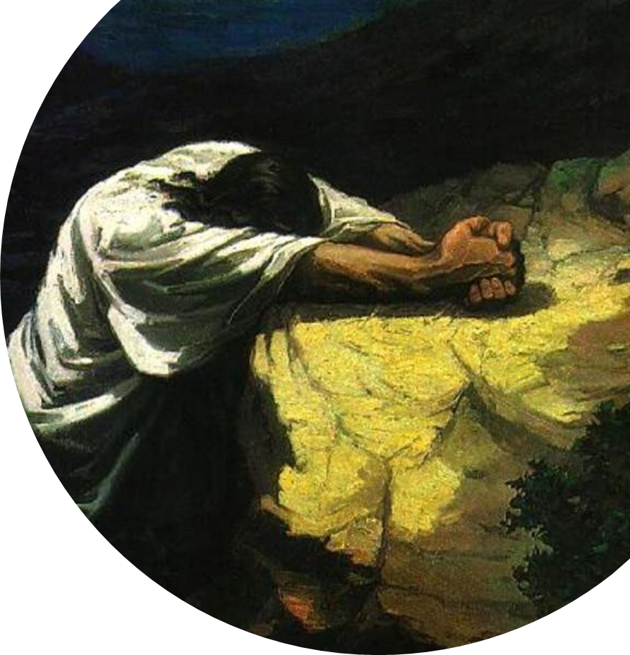
Jesus
Even Jesus Himself was deeply anguished over what lay before Him.
Isaiah prophesied that Christ would be "a man of sorrows, and acquainted with grief." Isaiah 53:3
Luke 12:50 – “I have a baptism to be baptised with, and how great is my distress until it is accomplished!”
Luke 22:39-44 – “And being in agony he prayed more earnestly; and his sweat became like great drops of blood falling down to the ground.”

Slide 12
How did God treat people who were discouraged?
Have you noticed that God didn’t condemn these people for their questions and pain. He reached down to their deepest pit of suffering, and lifted them out.
God cared and showed compassion. He brought hope and gave them victory.
God works the same way today! We have a Saviour who understands our pain, who knows about every weakness and hurt, and reaches out with compassion and hope.
If you find yourself in dark places today, know that you’re not alone. God knows your way, is with you always, and has good still in store.

Slide 13
Jesus understands when we are discouraged and wants us to go to him when we feel anxious or distressed!
Notes:
First of all, I want you to understand that God understands when we are discouraged! However, he wants us to go to him and let him help us through the difficult time.

Slide 14
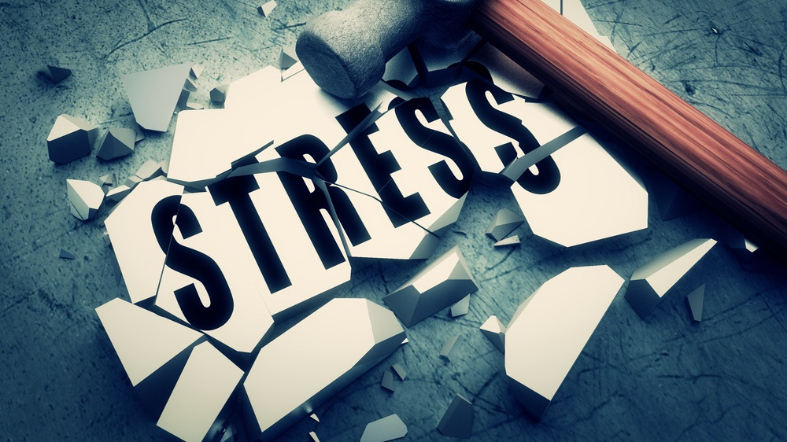
Practical advice
There are small practical things we can do in order to keep ourselves in the best mental state:
Have a routine
Try to eat a healthy diet
Avoid alcohol
Be more active
Stay in touch
“Do your best and let God do the rest!”
Notes:
Have a routine: When people feel down, they can get into poor sleep patterns, staying up late and sleeping during the day. Try to go to bed and get up at your normal time and stick to your routine as much as possible.
Try to eat a healthy diet: Some people don't feel like eating when they're depressed and are at risk of becoming underweight. Others find comfort in food and can put on excess weight.
Avoid alcohol: It won't help you solve your problems and could also make you feel more depressed.
Be more active: Take up some form of exercise. There's evidence that exercise can help lift your mood.
Stay in touch: Don't withdraw from life! Socialising can improve your mood. Keeping in touch with friends and family means you have someone to talk to when you feel low.

Slide 15
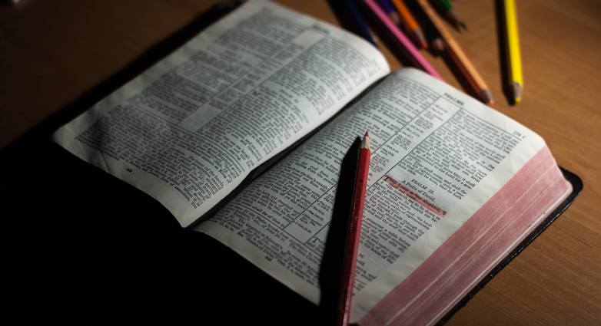
Practical advice: What can we do?
Advice from the Bible

Slide 16
1. Watch what you let into your heart! “Above all else, guard your heart, for everything you do flows from it.” (Proverbs 4:23)
TEST your preference:
Does it bring you closer to God?
Does it lift you up or pull you down?
Do you feel emotionally stable after watching/reading/listening to it or does it unsettle you?
What do you read/watch?
What kind of music do you listen to?
What do you spend your free time with?
“I have the right to do anything,” you say—but not everything is beneficial. (1Cor 10:23)
Notes:
The word ‘heart’ does not refer to the muscle in our chest that pumps blood. It refers to the essence of the self. The centre of our total personality.
It refers to who we are at core. The real you. The real me.

Slide 17
2. STOP ‘Negative Thinking’
What do you think about right before you start feeling low? What triggers this feeling?
It's vitally important for you to find out what God says is the truth about you and your life.
"For God so loved the world, that he gave his only Son, that whoever believes in him should not perish but have eternal life.“ (John 3:16)
"See what great love the Father has lavished on us, that we should be called children of God! And that is what we are!“ (1 John 3:1)
Notes:
What do you think about right before you feel discouraged?
Do you think such things as "I'm no good," or "I can't do anything right," or "This situation will never change"?

Slide 18
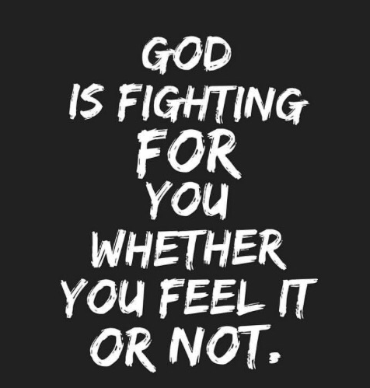
3. Don’t be led by your emotions
The problem comes when we begin to believe that ‘what we feel must be the truth’.
It is never safe to “follow your heart” because our hearts are deceitful and desperately wicked (Jer. 17:9).
“Trust in the LORD with all your heart, and do not lean on your own understanding” (Proverbs 3:5)
Notes:
Instead of following our hearts, we should trust in the Lord!

Slide 19
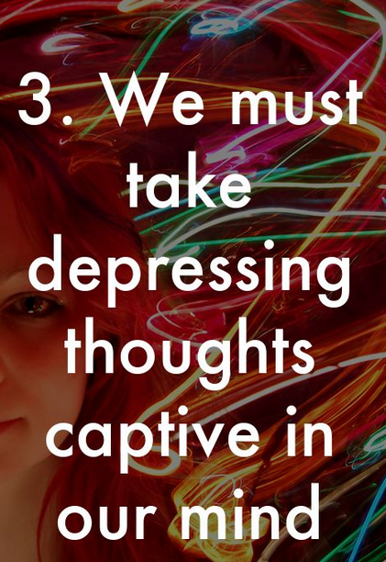
4. The Bible teaches about ‘disciplining our thoughts’
“We take captive every thought to make it obedient to Christ.” (2 Corinthians 10:5)
STOP repeating negative things to yourself!
Memorise and repeat to yourself the truths you find in the Bible to CONTRADICT the negative thoughts!
“God doesn’t want us to be a captive to our thoughts – He wants us to hold our thoughts captive” (Christina Cook Lee)
Notes:
Once you find out the wonderful things God says about you, stop repeating negative things to yourself.
Instead, memorise and repeat to yourself the truths you find in the Bible that contradict the negative thoughts.
Philippians 4:8, NIV: "Finally, brothers and sisters, whatever is true, whatever is noble, whatever is right, whatever is pure, whatever is lovely, whatever is admirable--if anything is excellent or praiseworthy--think about such things."

Slide 20
“The Invisible War”
“The Invisible War is the battle for your mind, and that battle is vicious. It is intense. It is unrelenting, and it is unfair because Satan never plays fair. And the reason why it is so intense is that your greatest asset is your mind. …
I have seen the face of mental illness. I have seen what it is like when people are unable to hear God because their minds are broken and cannot seem to connect to God even when they want to connect to God. And I know whatever gets your mind gets you.
So one of the most important things we need to learn and teach others is how to guard, strengthen, and renew our minds, because the battle for sin always starts in the mind.” (Donald Grey Barnhouse)
Notes:
We need to understand that we have an enemy, who wants us to be discouraged! He wants us to be as far from God as possible. He wants us to stay in darkness, because he know that we will become unable to connect with God.

Slide 21
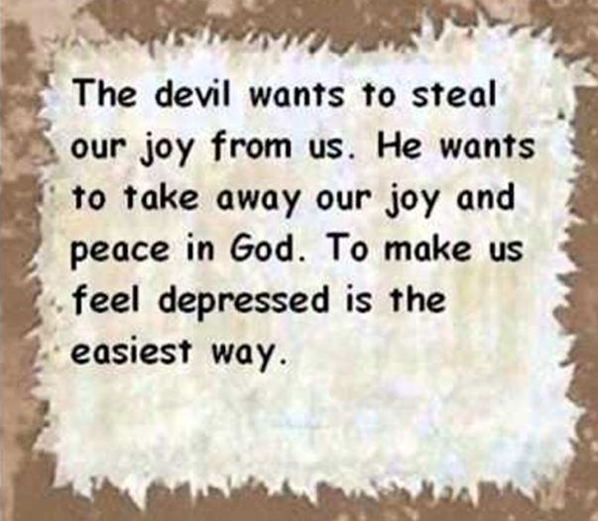
The Invisible War – 2 Cor 10:3-5
“For though we live in the world, we do not wage war as the world does. The weapons we fight with are not the weapons of the world. On the contrary, they have divine power to demolish strongholds.
We demolish arguments and every pretension that sets itself up against the knowledge of God, and we take captive every thought to make it obedient to Christ.”
Notes:
So how can we guard and strengthen our mind? “We take captive every thought to make it obedient to Christ”.

Slide 22
God gives us the ‘weapons’ in this war
“Submit yourselves, then, to God. Resist the devil, and he will flee from you.” (James 4:7)
Use God’s strength to manage the situation
Ask for God’s help when negative thoughts are coming knowing that those dark thoughts are from the Enemy.
Pray for God’s power: “God’s grace is sufficient and His power is made perfect in weakness” (2 Cor 12:9)
Trust that he is able to strengthen you and he wants to empower you: “I can do all things through Him who strengthens and empowers me.” (Philippians 4:13)

Slide 23
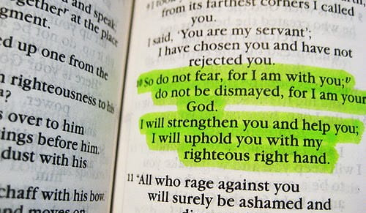
“Do not fear – God is greater”
“For our struggle is not against flesh and blood, but against the rulers, against the powers, against the world forces of this darkness, against the spiritual forces of wickedness in the heavenly places” (Ephesians 6:12)
The good news is that Jesus has already won this ‘invisible war’ and we don’t have to fear. This alone should chase away all of our dark thoughts.
God gives us the power to live courageously, boldly, fearlessly in this life, when many things that surround us would tell us to be afraid.

Slide 24
Our Choice
Who do you want to believe: God or Satan?
God has promised His help and the strength we need, but we must choose who we want to listen to!
Choose not to allow fear and anxiety to control your life.
Choose to guard your heart.
Choose to focus your mind on what is true in the midst of uncertain times.

Slide 25
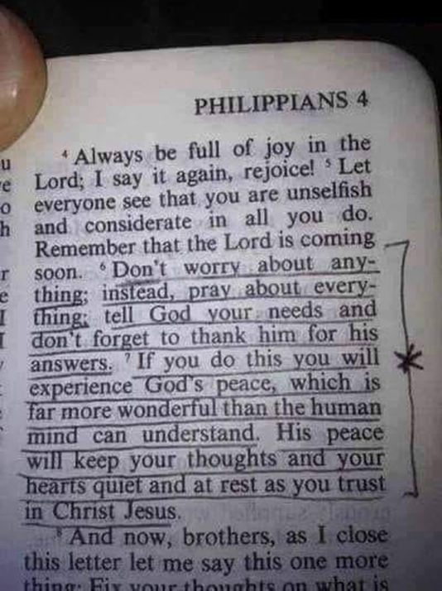
“Do not worry! Do not fear.” (365 or 145 times?)
“Are you worried about the future? Give it to Him – again. Replace those fearful thoughts with His words of truth. And sleep in peace tonight. He knows what concerns you, He’s got you covered.” (Debbie McDaniel)
“ For God has not given us a spirit of fear, but of power and of love and of a sound mind.” (2 Timothy 1:7)
Remember, you can trust Him and put all your worries, anxieties on Him, because he promised that he will take care of us. (1 Peter 5:7)
Notes:
The whole Bible is full with the message: Do not worry! Do not fear!
I’ve heard that this message can be found 365 times in the Bible, but apparently it’s not quite true. Someone has actually counted it and found only 145 ‘Do not worry’ messages. I think the number doesn’t really matter – as the message is clear, whether it is written 365 times or 145 times! So it’s our choice to believe what God says or reject it!
My advice is to read God’s promises daily, soak them in and think about them. There is power in His Word that can helps us in the difficult time.
We may not be in control, but we can trust the One who is. We may not know the future, but we can know the God who does.

Slide 26
Notes:
Indeed! Why should we be in despair? The Psalmist encourages us to HOPE in God! And that’s the key! If we do hope in God, we can go to him and He will chase away the darkness!

Slide 27
The Bible’s answer to stress and discouragement
“The thief comes only to steal and kill and destroy; I have come that they may have life, and have it to the full.” (John 10:10)
Jesus is Life – Hope – Peace – Light of the World!
The closer we go to Jesus, the further away we get from the darkness!
“May the God of hope fill you with all joy and peace as you trust in him, so that you may overflow with hope by the power of the Holy Spirit.” (Romans 15:13)
Notes:
Jesus came to give us ‘life’! The same way as a baby needs ONLY his mother/parent in order to fulfil all of his needs, we need only Jesus! He gives us what we need! He wants to free us from the darkness – including the darkness in us. He wants us to have life to the full.
He is with you in whatever you face, in the turmoil and struggles, amidst the anxious thoughts and the worries of life. He is there, strengthening, helping, and He holds you in His hands.
Jesus left everything behind and came to this World for us – so that we would have life and have it to the full! This is the message of Christmas.

